Slide 1


Weather Prediction
Preetham Thatikonda(02182487)
Roshan Pampari(02143843)
Sarvagna Kotte(02185847)
Anusha Musirika(02199061)
Jayanth Mekala(02173552)

Slide 2
OVERVIEW
The goal of this project is to predict weather conditions, such as temperature, precipitation, or humidity, based on historical weather data. Using machine learning models, you can forecast future weather conditions by training on datasets that contain information about weather from the past (e.g., temperature, humidity, wind speed, pressure, and time-related features).
We want to predict a specific weather condition (e.g., daily temperature or precipitation) for a particular location or region based on historical weather data. The dataset will typically contain weather observations for multiple years, including temperature, wind speed, humidity, and other atmospheric conditions.

Slide 3
DATASET
The dataset contains detailed weather observations over a period of time, featuring hourly weather conditions. It has 96,453 entries and 12 columns.
Formatted Date: The timestamp of the observation.
Summary: A brief description of the weather condition (e.g., "Partly Cloudy", "Mostly Cloudy").
Precip Type: The type of precipitation (e.g., "rain", "snow").
Temperature (C):The actual temperature in Celsius.
Apparent Temperature (C):The "feels-like" temperature considering wind chill or humidity.
Humidity: The relative humidity as a ratio (0 to 1).

Slide 4
Wind Speed (km/h):The speed of the wind in kilometers per hour.
Wind Bearing (degrees):The direction the wind is coming from, measured in degrees.
Visibility (km):The distance to the furthest visible object in kilometers.
Loud Cover: Indicates cloud cover (constant value 0.0 throughout).
Pressure (millibars): The atmospheric pressure in millibars.
Daily Summary: A descriptive summary of the weather for the day (e.g., "Partly cloudy throughout the day").

Slide 5
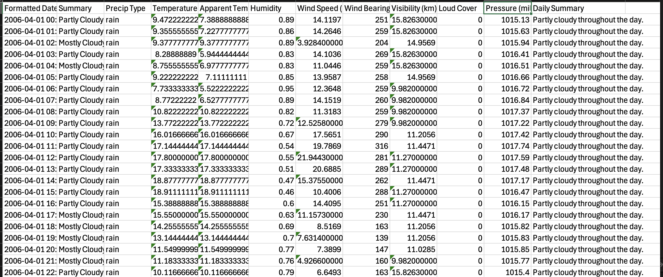
Glimpse of Data set

Slide 6

Data preprocessing and Feature engineerring
Cleaning Data: Handle missing values, remove outliers, and ensure the dataset is complete.
Feature Engineering:
Extract time-based features like month, day, year, day of week.
Aggregate the data to a daily or weekly level (depending on the forecasting granularity).
Convert categorical variables (like weather conditions) into numerical form if needed.
Handling Outliers:
There are 4 Features in our dataset which have outliers ( "humidity", "Temperature", "wind speed", "Pressure") , we have replaced our outliers with lower boundaries and Higher boundaries accordingly
Normalization/Scaling: Scale numerical features (e.g., temperature, wind speed, pressure) so that they are within a similar range for better performance of certain models (e.g., neural networks).

Slide 7
MODEL SELECTION
Several machine learning models can be used for weather prediction. Depending on the dataset and the type of weather variable you're predicting, you can use
Random Forest is an ensemble learning method primarily used for classification and regression tasks. It builds multiple decision trees during training and combines their outputs to produce more robust and accurate predictions.
An ensemble method that often performs well with structured data.
Linear Regression is a statistical method used for modeling the relationship between a dependent variable (target) and one or more independent variables (features).
We Start with a simple model like linear regression to predict temperature

Slide 8

EVALUATION
Train-Test Split: We split our data into training and test sets (e.g., 80% for training, 20% for testing).
For regression: We use RMSE (Root Mean Squared Error), MAE (Mean Absolute Error), R-squared, etc.
Final Outcome:
Linear Regression - MAE: 4.541174191687934
Linear Regression - RMSE: 5.593762545454751
Linear Regression - R²: 0.6604096443972614
Random Forest - MAE: 1.1506676752012024
Random Forest - RMSE: 1.6052647279507593
Random Forest - R²: 0.9720333388324416
VISUALIZATION: Plot Predictions vs. Actual Values, We Use scatter plots to compare predicted weather conditions with the actual values over time.

Slide 9
CONCLUSION
The primary reason why Random Forest performed better than Linear Regression in this case is likely the non-linearity of the relationships in the data, as well as the ability of Random Forest to capture feature interactions and handle complex patterns without requiring explicit modeling.
Linear regression, on the other hand, would have struggled with these aspects due to its assumption of linearity, sensitivity to multicollinearity, and potential underfitting in the presence of non-linear relationships.

